Slide 1
CSE/T/324A Computer Networks Topic 3- IEEE 802.x
Dr. Sarbani Roy
sarbani.roy@gmail.com
Office: CC-5-7
Cell: 9051639328

Slide 2
IEEE 802
IEEE 802 is a family of IEEE standards dealing with LAN and MAN.
More specifically, the IEEE 802 standards are restricted to networks carrying variable-size packets.
By contrast, in cell relay networks data is transmitted in short, uniformly sized units called cells.
Isochronous networks, where data is transmitted as a steady stream of octets, or groups of octets, at regular time intervals, are also out of the scope of this standard.
The number 802 was simply the next free number IEEE could assign, though “802” is sometimes associated with the date the first meeting was held — February 1980.

Slide 3
802 Specifications
Set Standards for:
Network Interface Cards (NICs)
Wide area network (WAN) components
Components used to create twisted-pair and coaxial cable networks

Slide 4
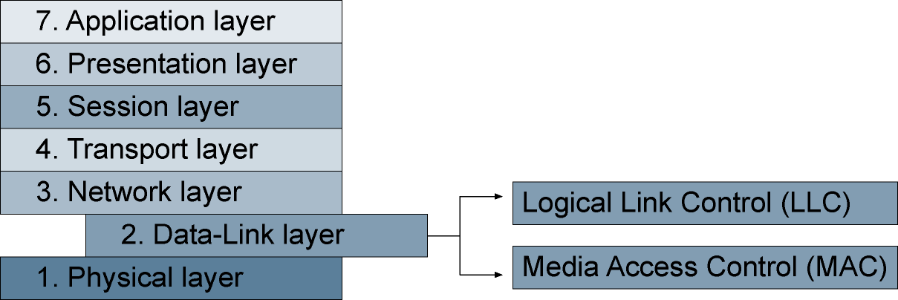
Project 802 LLC and MAC Sublayers

Slide 5
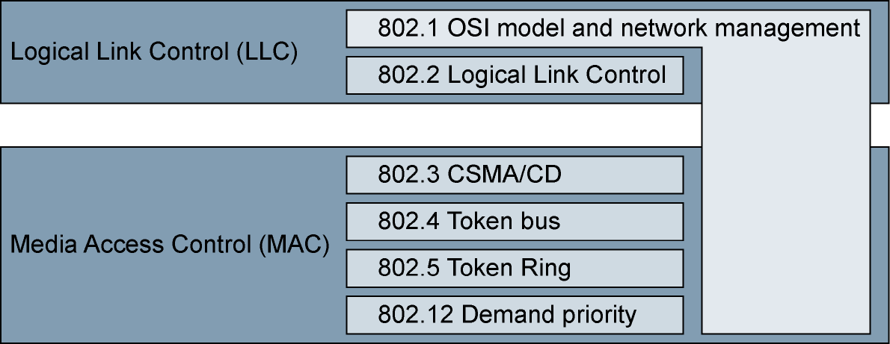
Project 802 LLC and MAC Standards

Slide 6
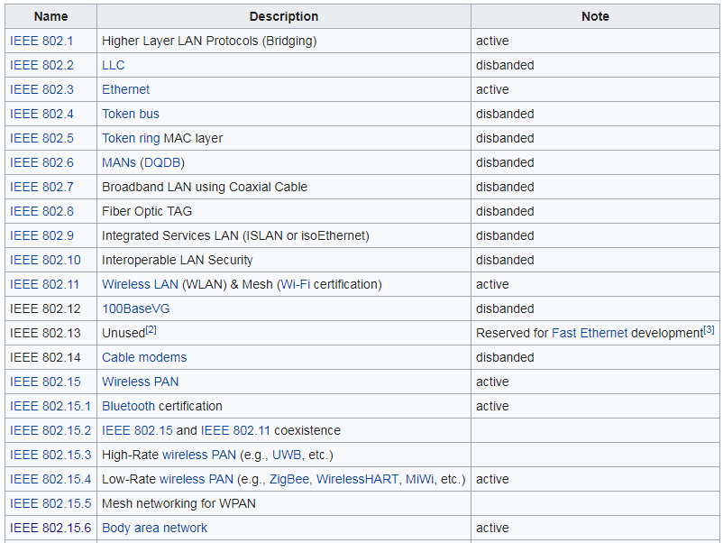

Slide 7
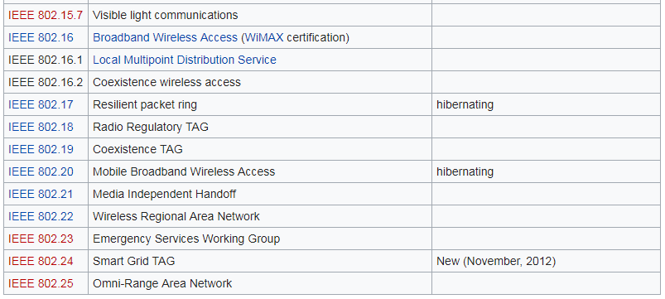

Slide 8
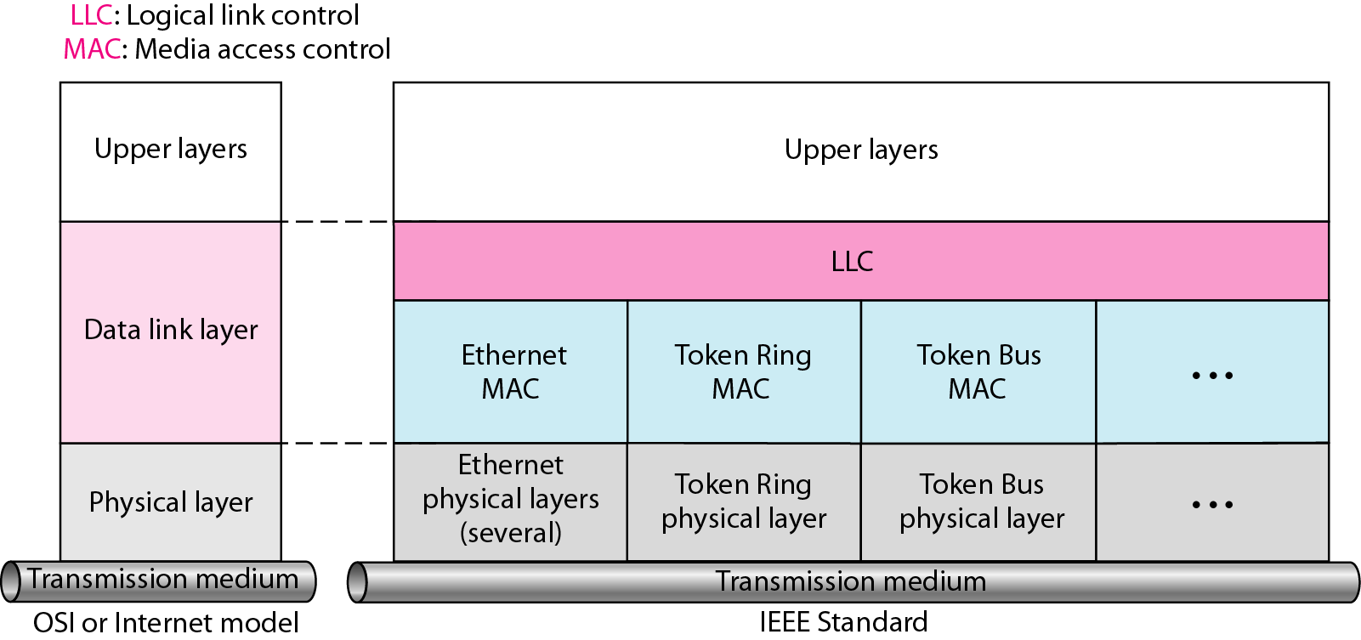
IEEE standards for LAN

Slide 9
Traditional Ethernet uses 1-persistent CSMA/CD as the access method

Slide 10
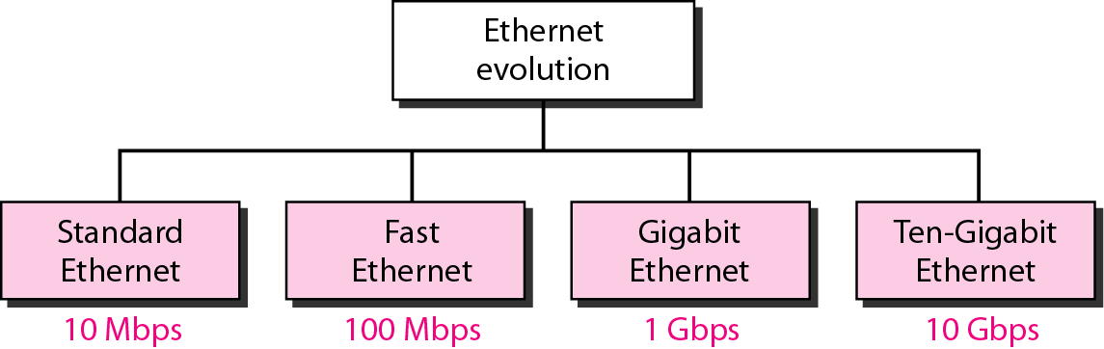
802.3 Ethernet

Slide 11
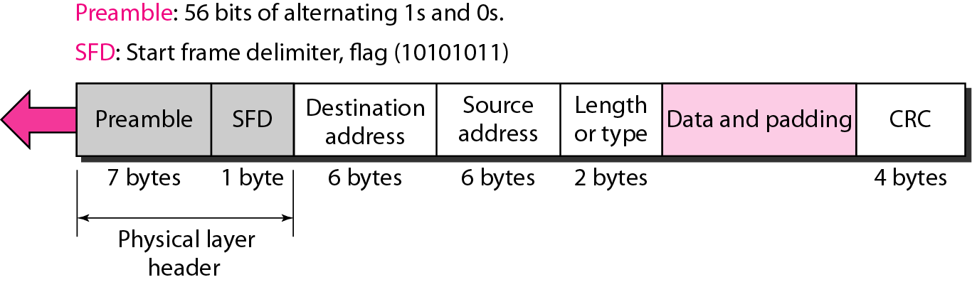
802.3 MAC frame

Slide 12
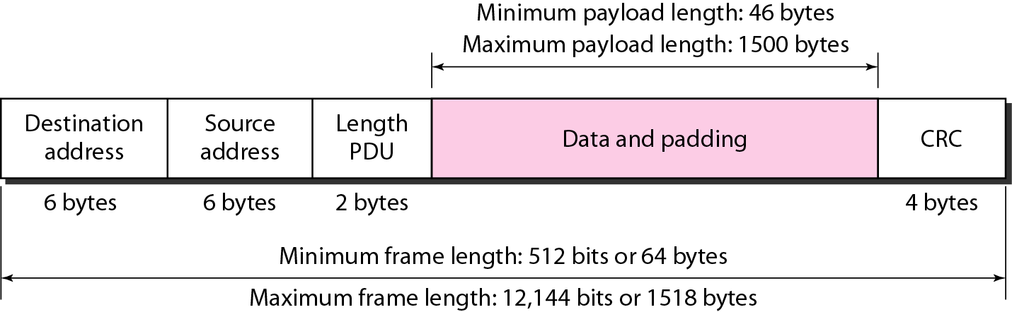
Minimum and Maximum Lengths

Slide 13
Note
Frame length:
Minimum: 64 bytes (512 bits) Maximum: 1518 bytes (12,144 bits)

Slide 14
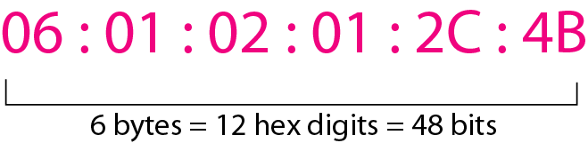
Example of an Ethernet address in hexadecimal notation

Slide 15
Source address is always a unicast
Destination address can be unicast, multicast or broadcast

Slide 16
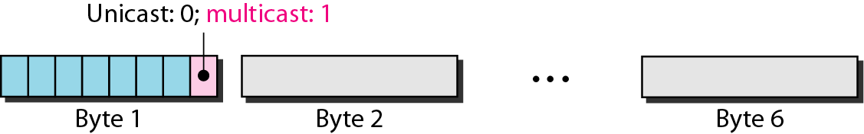
Unicast and multicast address
The least significant bit of the first byte defines the type of address. If the bit is 0, the address is unicast; otherwise, it is multicast.
The broadcast destination address is a special case of the multicast address in which all bits are 1s.

Slide 17
Define the type of the following destination addresses:
a. 4A:30:10:21:10:1A b. 47:20:1B:2E:08:EE
c. FF:FF:FF:FF:FF:FF
Solution
To find the type of the address, we need to look at the second hexadecimal digit from the left. If it is even, the address is unicast. If it is odd, the address is multicast. If all digits are F’s, the address is broadcast. Therefore, we have the following:
a. This is a unicast address because A in binary is 1010.
b. This is a multicast address because 7 in binary is 0111.
c. This is a broadcast address because all digits are F’s.

Slide 18
Show how the address 47:20:1B:2E:08:EE is sent out on line.
Solution
The address is sent left-to-right, byte by byte; for each byte, it is sent right-to-left, bit by bit, as shown below:

Slide 19
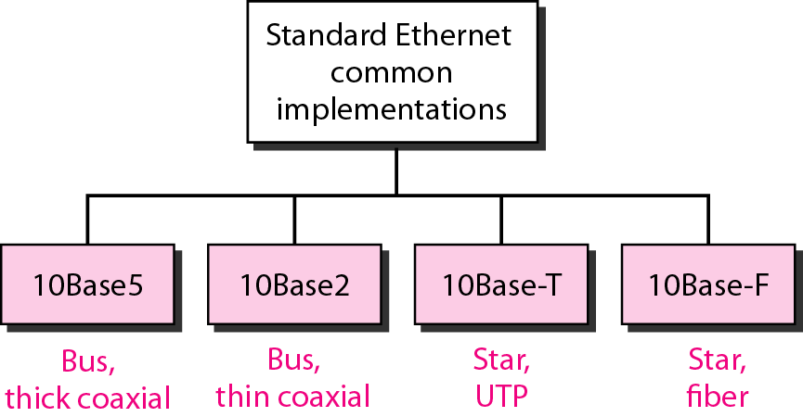
Categories of Standard Ethernet

Slide 20
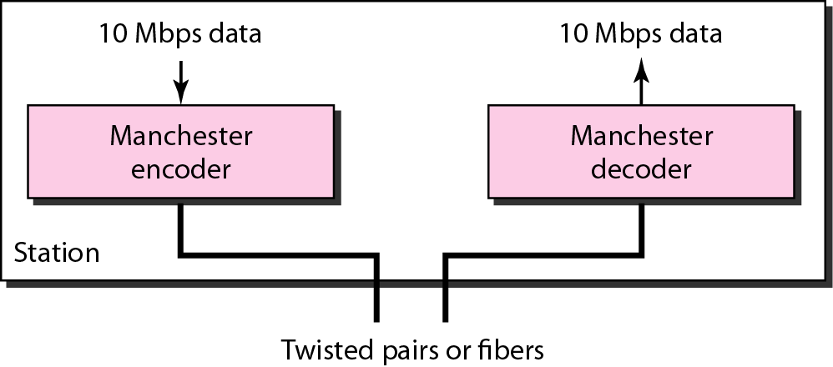
Encoding in a Standard Ethernet implementation

Slide 21
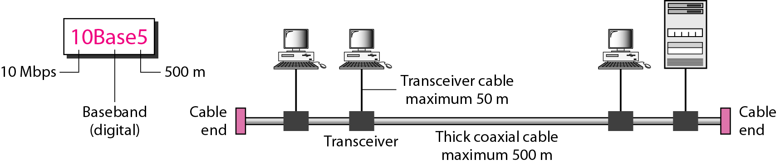
10Base5 implementation

Slide 22
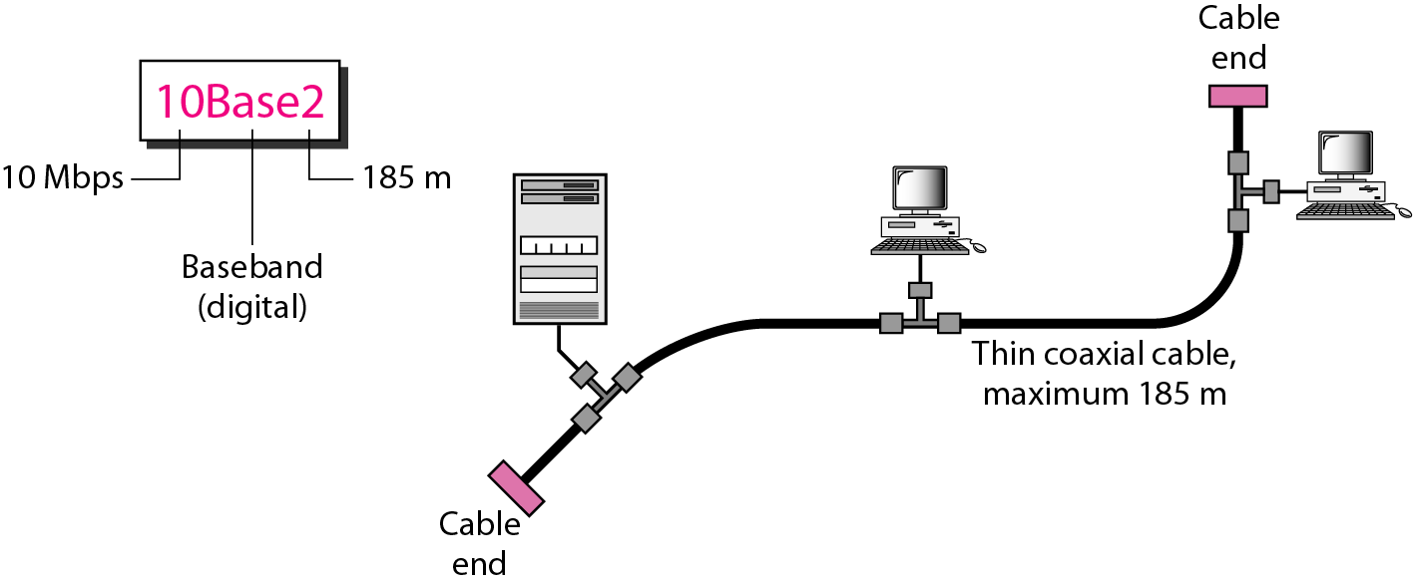
10Base2 implementation

Slide 23
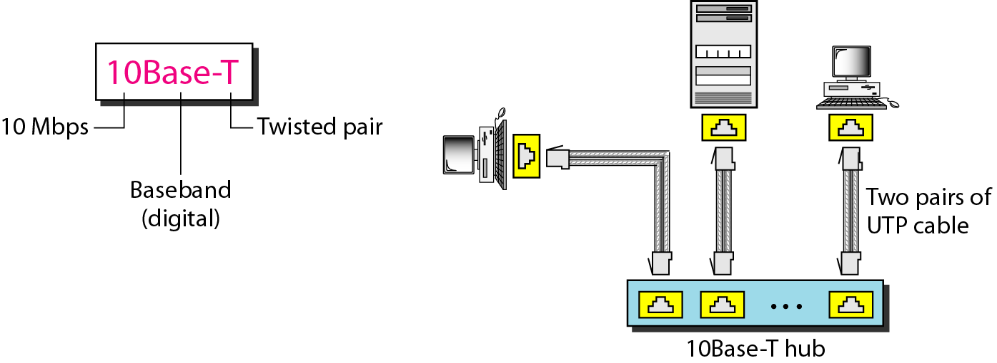
10Base-T implementation

Slide 24
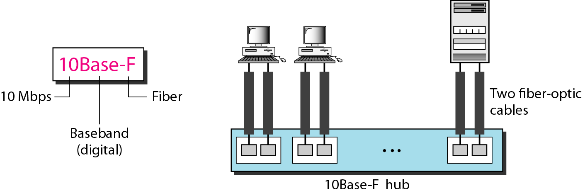
10Base-F implementation

Slide 25
Summary of Standard Ethernet implementations

Slide 26
Changes
The 10-Mbps Standard Ethernet has gone through several changes before moving to the higher data rates.
These changes actually opened the road to the evolution of the Ethernet to become compatible with other high-data-rate LANs.

Slide 27
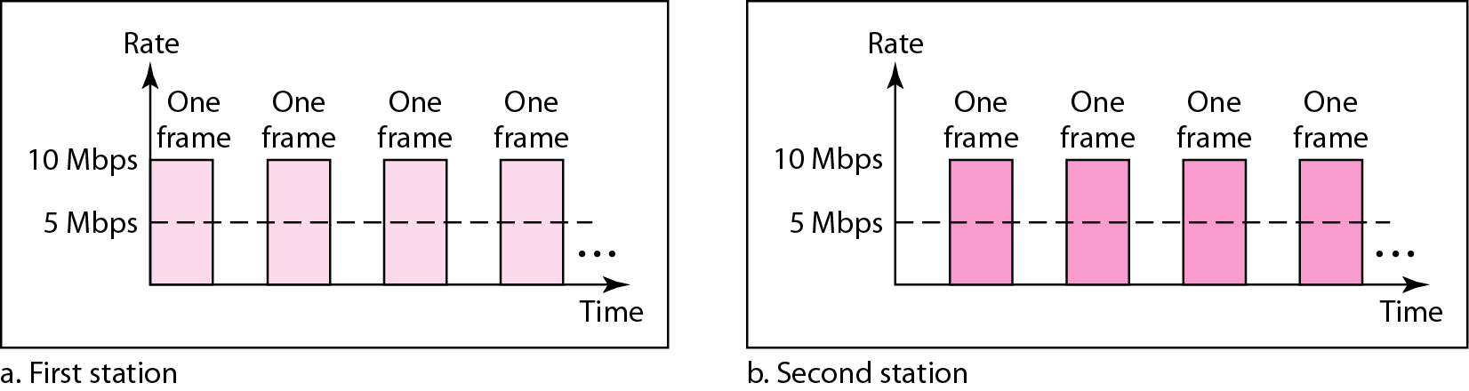
Sharing bandwidth

Slide 28
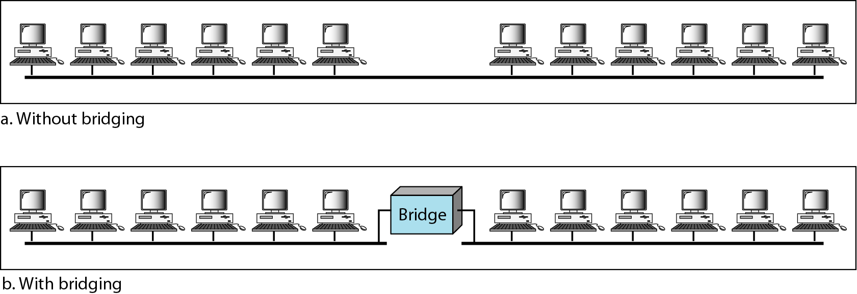
A network with and without a bridge

Slide 29
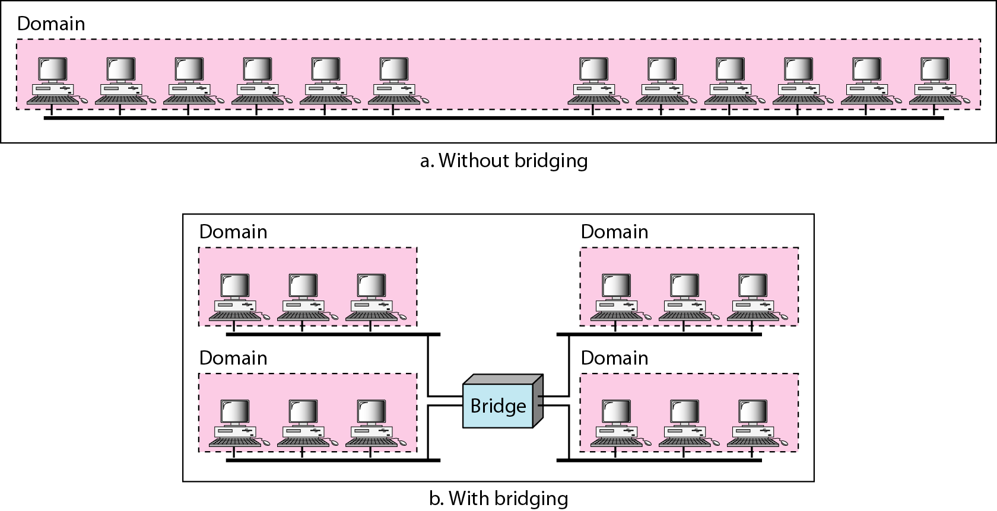
Collision domains in an unbridged network and a bridged network

Slide 30
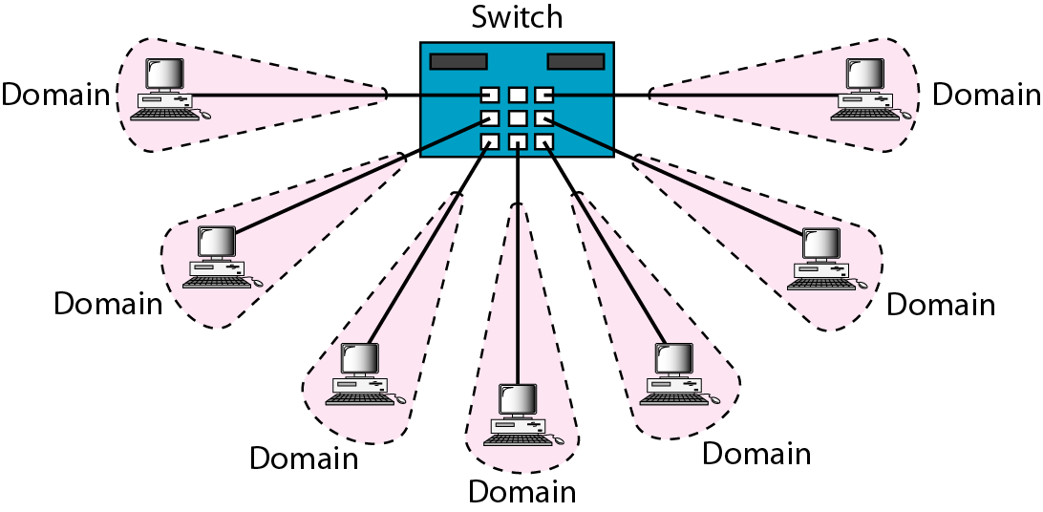
Switched Ethernet

Slide 31
Limitations of 10Base5 and 10Base2 is that communication is half duplex a station can either send or receive, but not at the same time
10BaseT is full duplex

Slide 32
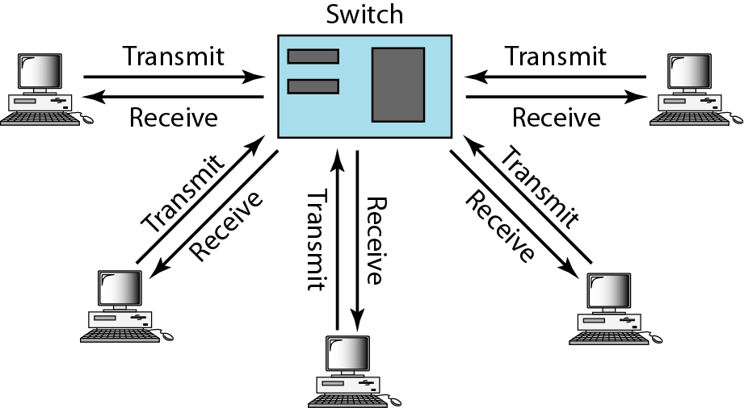
Full-duplex switched Ethernet

Slide 33
No need for CSMA/CD
In full duplex switched Ethernet, there is no need for the CSMA/CD.
Here, each node is connected to the switch via two separate links.
Each link is a point-to-point dedicated path between the station and the switch.
There is no more need for carrier sensing; there is no more need of collision detection.

Slide 34
Fast Ethernet
Fast Ethernet was designed to compete with LAN protocols such as FDDI or Fiber Channel.
IEEE created Fast Ethernet under the name 802.3u.
Fast Ethernet is backward-compatible with Standard Ethernet, but it can transmit data 10 times faster at a rate of 100 Mbps.

Slide 35
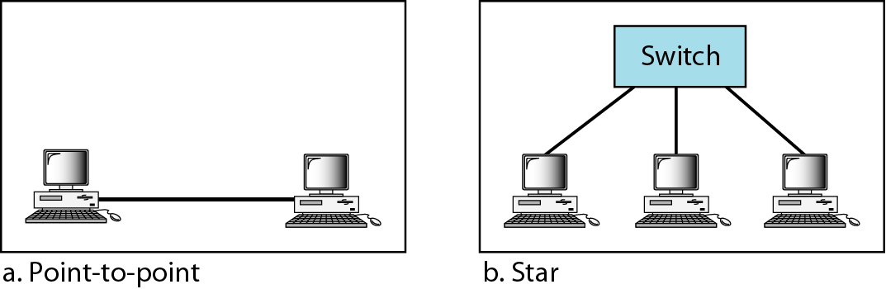
Fast Ethernet topology

Slide 36
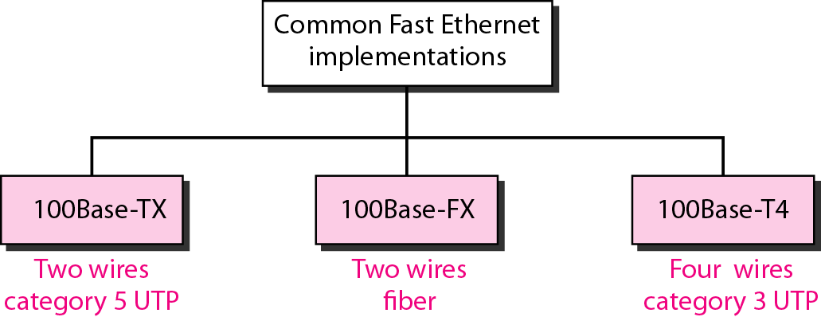
Fast Ethernet implementations

Slide 37
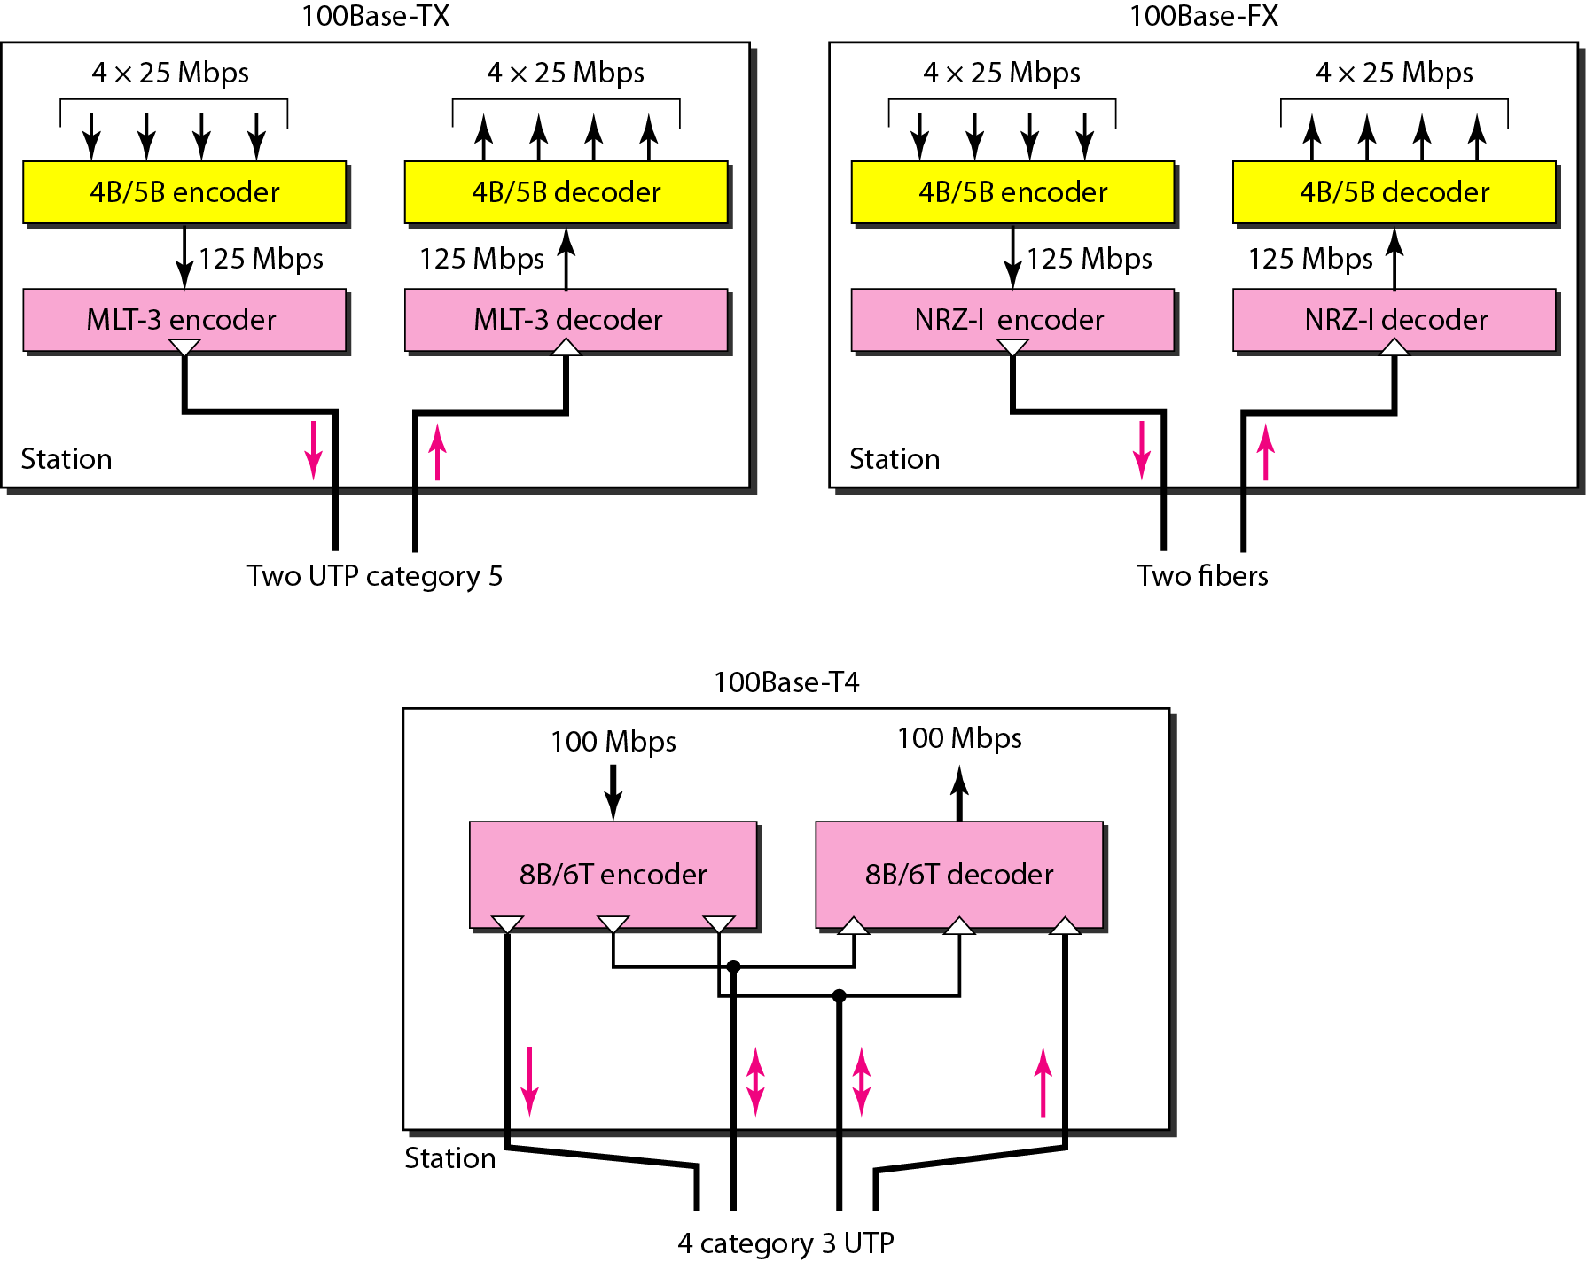
Encoding for Fast Ethernet implementation

Slide 38
Summary of Fast Ethernet implementations

Slide 39
Gigabit Ethernet
The need for an even higher data rate resulted in the design of the Gigabit Ethernet protocol (1000 Mbps). The IEEE committee calls the standard 802.3z.
In the full-duplex mode of Gigabit Ethernet, there is no collision;
the maximum length of the cable is determined by the signal attenuation in the cable.

Slide 40
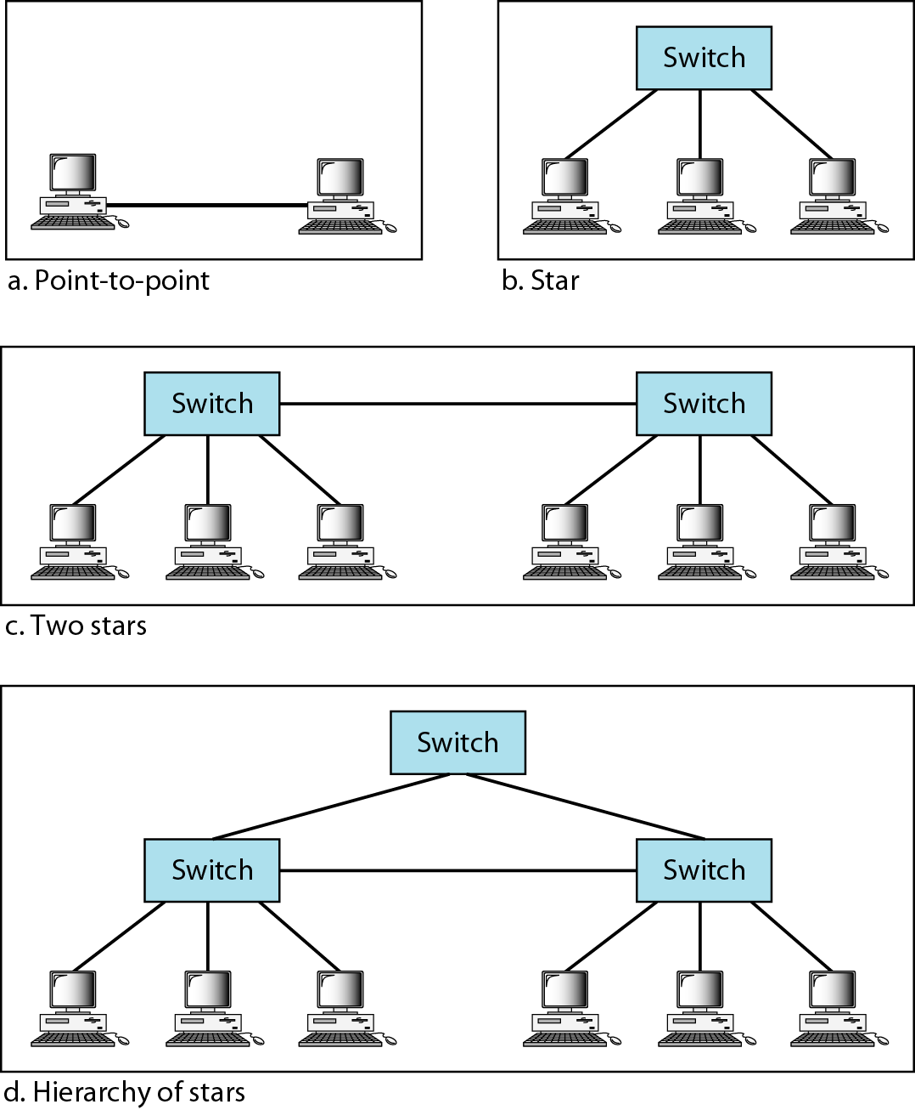
Topologies of Gigabit Ethernet

Slide 41
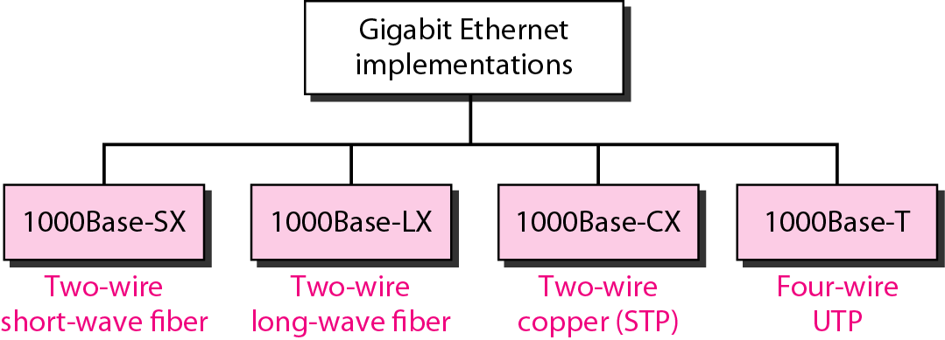
Gigabit Ethernet implementations

Slide 42
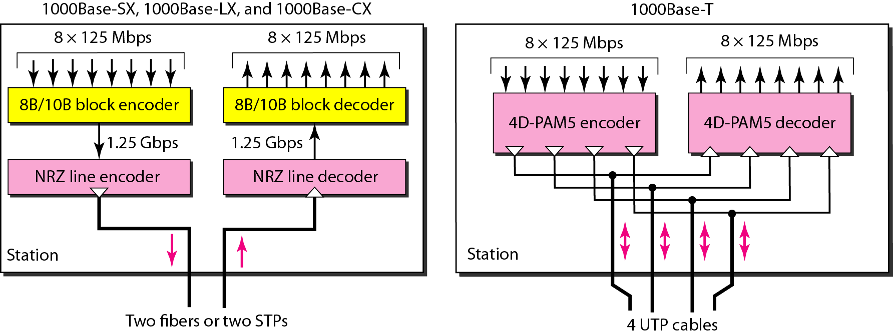
Encoding in Gigabit Ethernet implementations

Slide 43
Summary of Gigabit Ethernet implementations

Slide 44
Summary of Ten-Gigabit Ethernet implementations

